Slide 1


Cloud for AI
Course 10: Serving & Deployment
Filotas Theodosiou

Slide 2
Model Serving

Slide 3



What exactly is Serving a Model
Training a model is only phase 1
Provide a service or an API for interaction
We need to make the model available to the end-user

Slide 4
Model Serving Patterns
A fitted model
An interpreter
Input data
Inference Process
Used by

Slide 5
ML workflows
Make set of predictions based on historical input data
Sufficient for non-time dependant data
Model training (Offline)
Model prediction
Batch Inference
Online Inference
Predictions generated in real-time
Input data at the time of request

Slide 6
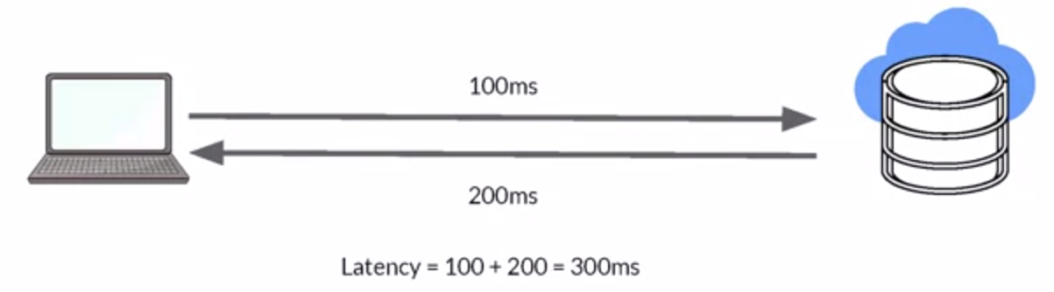
Latency
Delay between user’s action and response of application to these actions
Latency of the whole process, starting from sending data to server, performing inference using model and returning response
Minimal latency is a key requirement to maintain customer satisfaction

Slide 7
Throughput
Throughput -> Number of successful requests served per unit time say one second.
In some application only throughput is important not latency
(For example video from security cameras at high fidelity to ensure security events are spotted quickly )

Slide 8

Cost
The cost associated with each inference should be minimised
Critical infrastructure requirements that are expensive
CPU
Hardware accelerators like GPU
Caching infrastructure for faster data retrieval

Slide 9
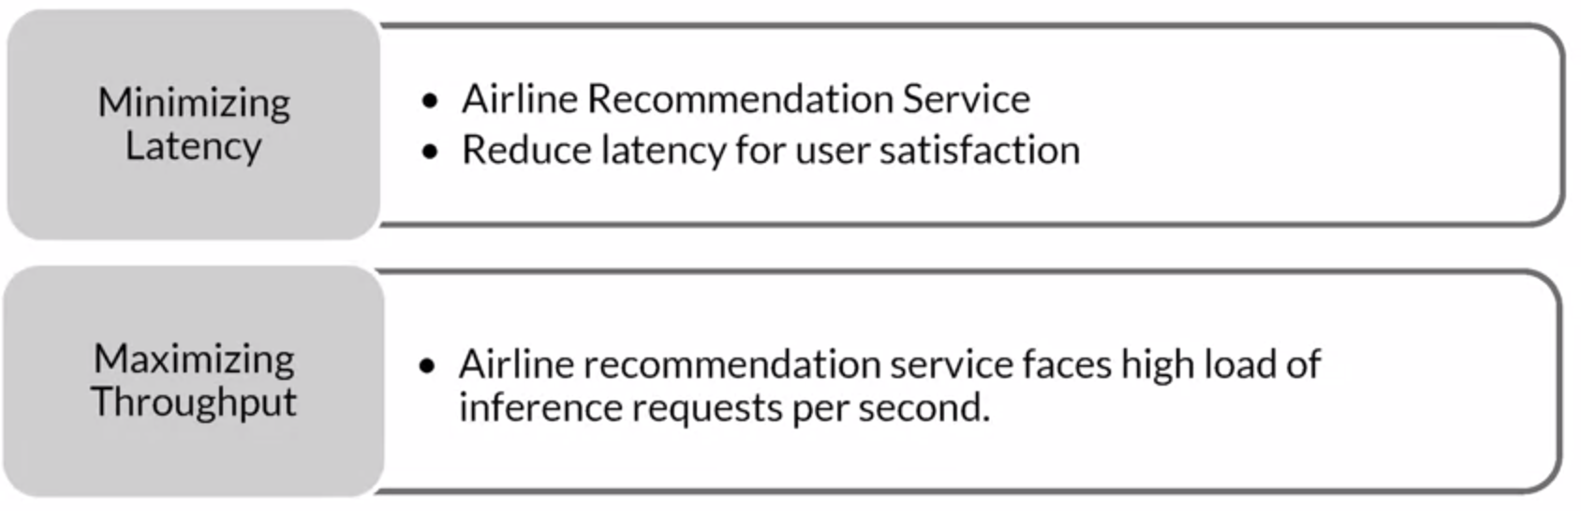
Minimizing latency, Maximizing Throughput

Slide 10

Balance Cost, Latency, and Throughput
Cost increases as infrastructure is scaled
In applications where latency and throughput can suffer slightly:
Reduce costs by GPU sharing
Multi-model serving
Optimizing models used for inference

Slide 11
Resources and
Requirements for
Serving Models

Slide 12
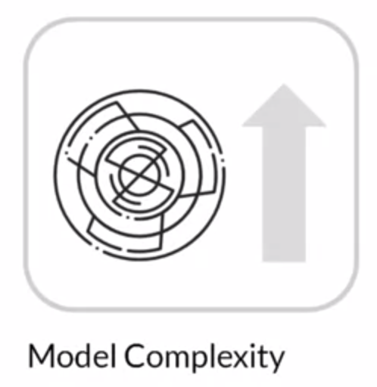
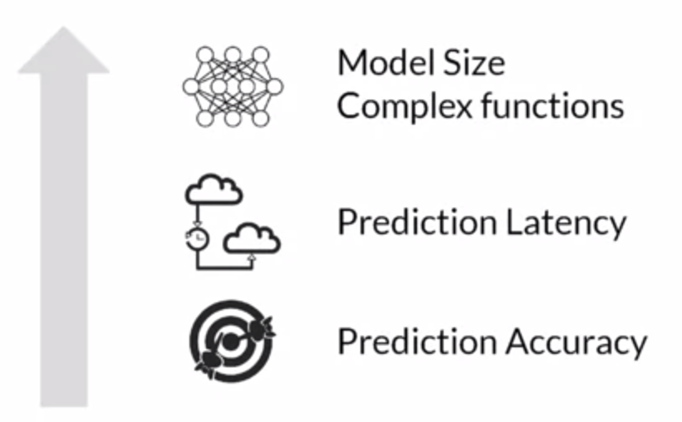
Optimizing Models for Serving
Model complexity increases
Increase in

Slide 13
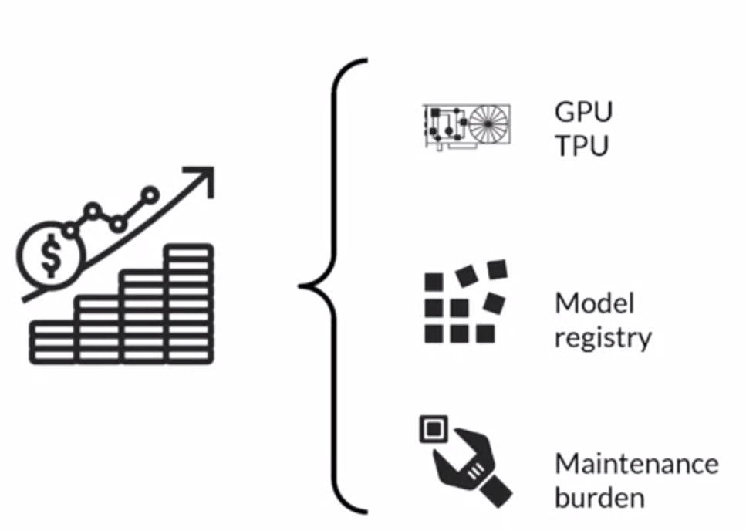
Meanwhile as Complexity Increases
Costs also do increase
Increase in
Model complexity increases

Slide 14

Balancing Cost and Complexity
The challenge for Data Scientist/ML practitioners is to balance complexity and cost

Slide 15
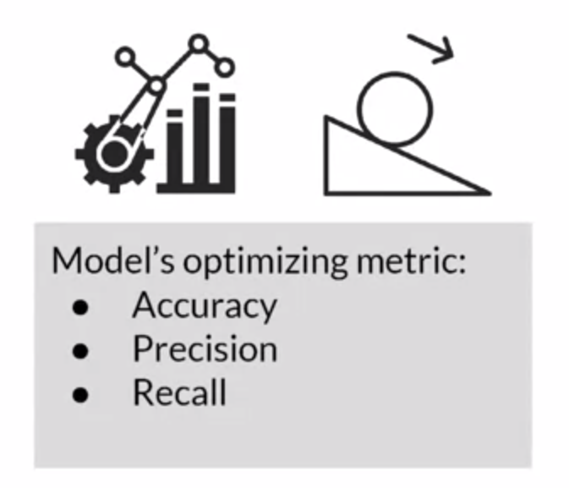
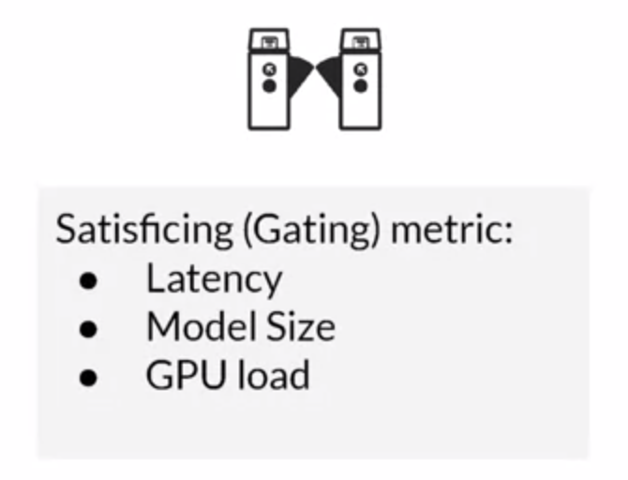
Optimizing and Satisfying Metrics

Slide 16
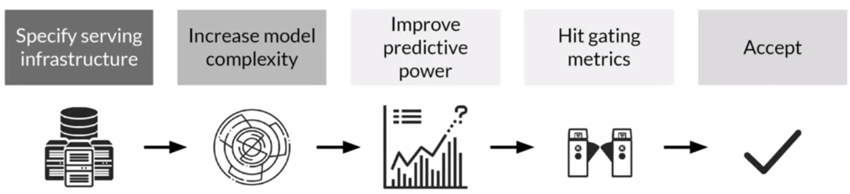
A common approach
Specifically define your infrastructure
CPU, GPU etc
Start increasing the complexity
In order to increase predictive power
Until you hit a one of your gating metrics
Either accept or start again

Slide 17

Caching
During a projects life cycle we constantly repeat data processing steps in different combinations
We need to minimize wasted work to maximize efficiency
What we do? We organize pipelines and caching.
Iteration efficiency: Reduce cost of frequent iteration
Increase productivity: Speeding up iteration frequency helps make problems faster
Reduce costs: Your monthly cloud bills will go way down!!

Slide 18
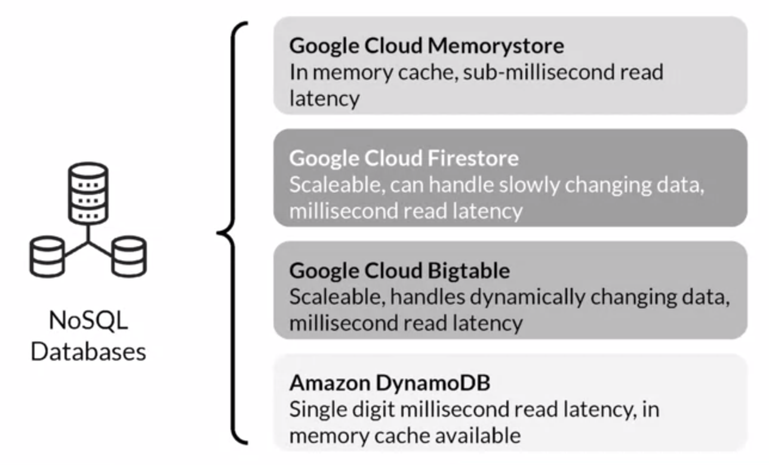
Caching and Feature Lookup
NoSQL databases are a good solution to implement caching.
Some examples:

Slide 19
Deployment Options

Slide 20


Deployment Options
A centralized model
In a huge data center
Access is given by remote calls
Distribute unique instances of your model on embedded devices
Local loading
Phones, personal computers etc

Slide 21
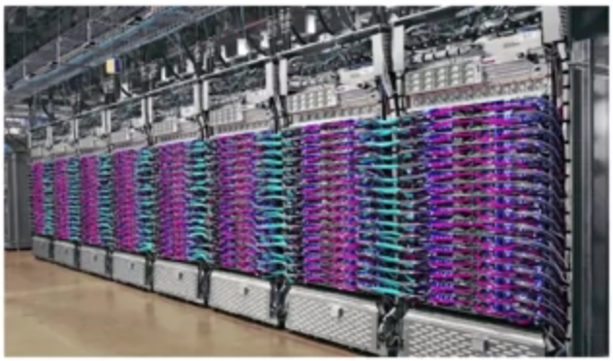
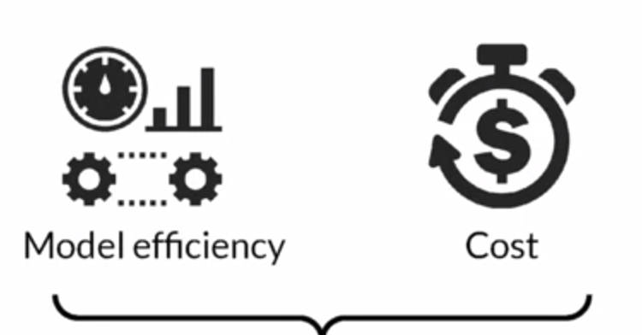
Running in Huge Data Centers
Big cloud providers
AWS
Google Cloud
Azure
They optimize resource utilization for you
They try to reduce running costs
Pay as you services

Slide 22
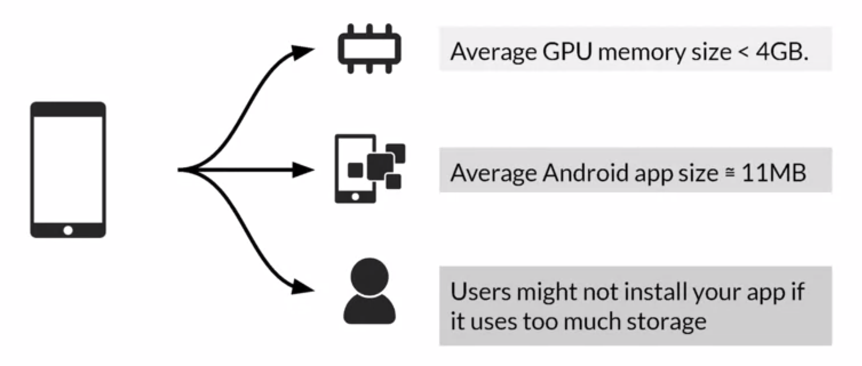
Phone devices
Huge Latency/Throughput gains
But

Slide 23
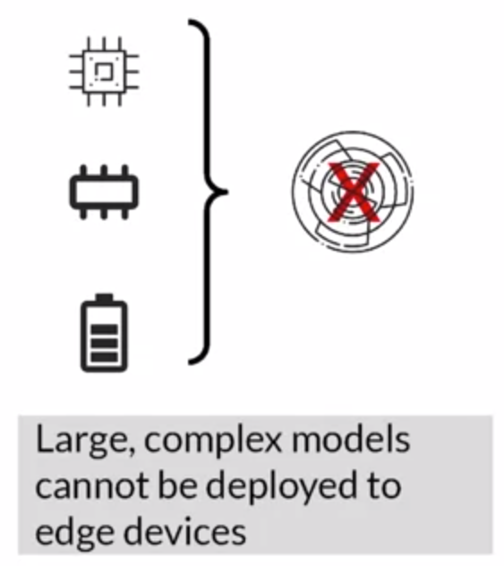
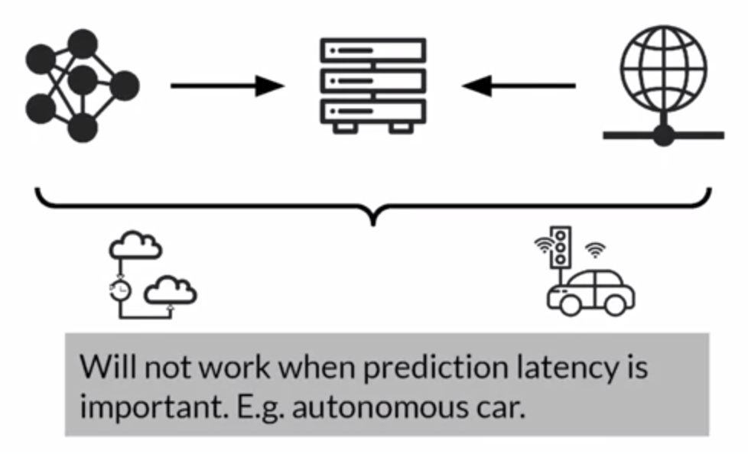
Constrained Environments
Local Devices
Cloud

Slide 24
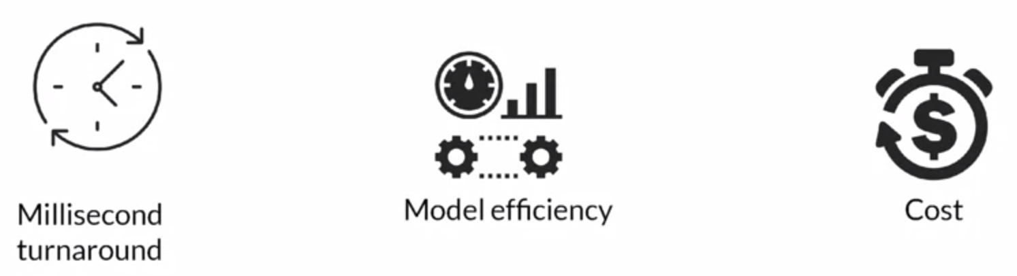
Prediction Latency is Almost Always Important
Opt for on-device inference whenever possible
Enhances user experience by reducing the response time of your app

Slide 25
Cloud Deployment

Slide 26
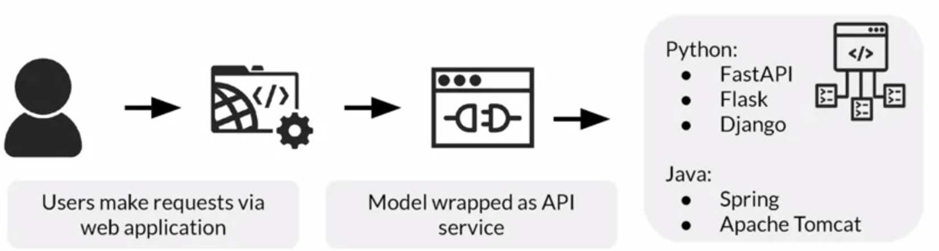
Web Application for Users

Slide 27
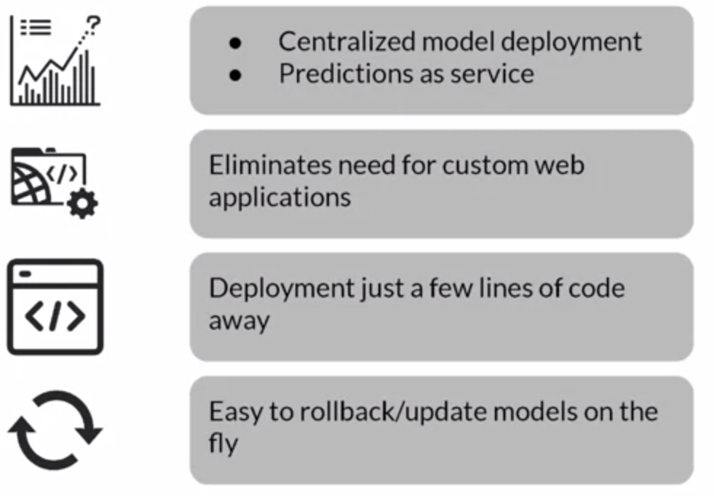
Serving Cloud Systems for easy deployment
Big cloud providers
AWS
Google Cloud
Azure

Slide 28
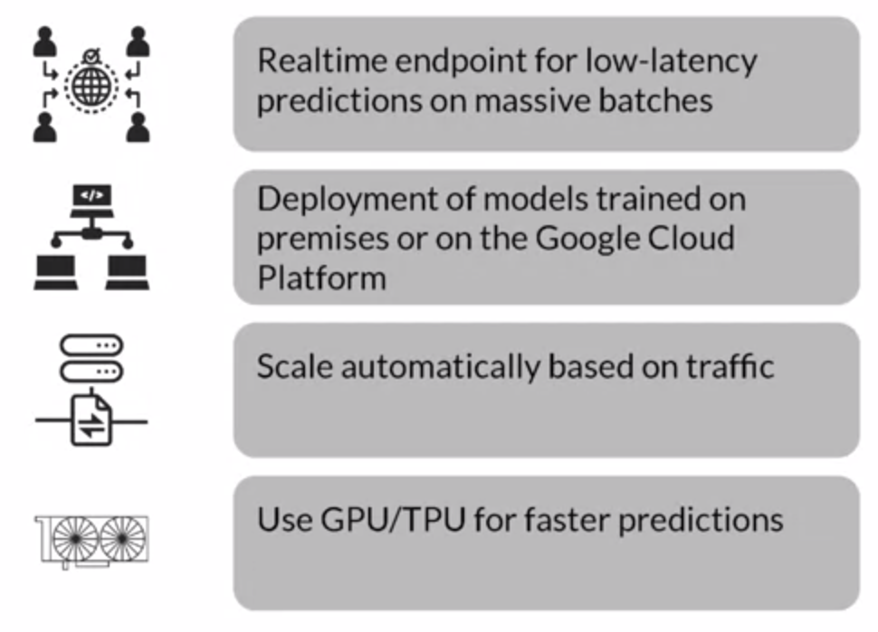
Advantages of Serving with a Managed Service

